Slide 1

Bank Loan Default Prediction Capstone II
Trip Fernandes
Springboard DSC
7/29/24

Slide 2
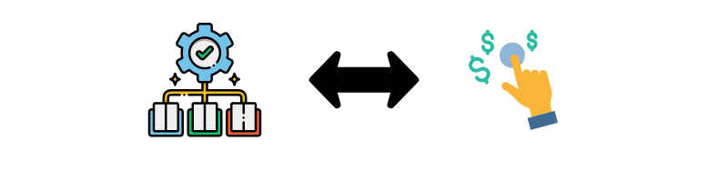
Introduction: Project Overview
Financial Challenge:
Loan defaults can significantly impact the financial stability and operational efficiency of banks.
Accurate prediction of defaults help in better resource allocation and risk mitigation.
Objective:
To develop a machine learning model to predict loan defaults using a dataset from Kaggle’s Loan Default Prediction Challenge

Slide 3

Dataset Overview
The dataset is from Kaggle’s Loan Default Prediction Challenge, providing a real-world scenario for analysis.
Size and Features:
Rows: 255,347
Columns: 18
Features include:
Demographics
Financial Indicators
Loan Characteristics

Slide 4
Methodology Overview
Data Wrangling:
Handling Missing Values: Checked for null values; no missing values were present
Encoding Categorical Variables: Use one-hot encoding for categorical features like ‘Education’, ‘EmploymentType’, etc resulting in 31 features
Handling Outliers: Applied interquartile range method to cap outliers in numerical columns
Scaling Features: Standardized numerical features to have zero mean and unit variance

Slide 5
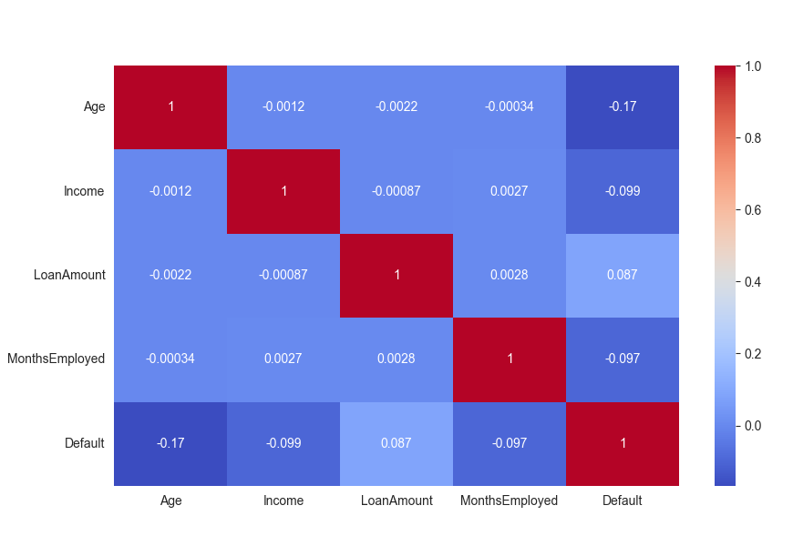
Methodology Overview
Exploratory Data Analysis (EDA):
Correlations: A heatmap was used to visualize the correlation matrix revealing the relationships between various features. Features like Income, Loan Amount, and Age showed significant correlations with the target variable – Default.

Slide 6
Methodology
Handling Class Imbalance:
Oversampling (SMOTE) - SMOTE generates synthetic samples for the minority class by interpolating between existing minority class samples. This helps increase the representation of the minority class without merely duplicating existing data points.
A specific sampling strategy was set to determine the number of synthetic samples to generate, targeting a controlled class distribution. In this project, the desired ratio between the minority and majority classes was adjusted to various levels (e.g., 0.6, 0.65) to explore the impact on model performance
The resampled class distribution after SMOTE showed an increased representation of the minority class (defaults), which is crucial for training the model to recognize this class more effectively.
Random Under-Sampling reduces the size of the majority class (non-defaults) by randomly removing samples. This technique helps to balance the dataset by decreasing the dominance of the majority class. This approach helps to mitigate overfitting on the majority class while ensuring sufficient minority class data for training.
By employing a combination of SMOTE and Random Under-Sampling, we achieved a more balanced dataset. This approach is essential for developing a robust model capable of accurately predicting loan defaults, thus supporting effective risk management and decision-making.

Slide 7
Machine Learning Models
Logistic Regression
A statistical model that predicts binary outcomes using a logistic function.
It’s a simple, interpretable model that provides probabilities for the target variable. Useful for understanding feature importance.
Random Forest
An ensemble method using multiple decision trees to improve predictive accuracy and control over fitting.
Handles high dimensionality well, provides feature importance, and is robust to overfitting.
Gradient Boosting Machines (GBM)
An ensemble technique that builds models sequentially, each new model correcting the errors of the previous ones.
Effective in handling complex datasets and capturing interactions between features.

Slide 8
Evaluation Metrics
Accuracy: The ratio of correctly predicted instances to the total instances.
Precision: The ratio of true positive predictions to the total positive predictions.
Recall: The ratio of true positive predictions to the actual positives in the dataset. This was a focus as the cost of false negatives is high (identified as did not default but did default)
F1-Score: The harmonic mean of precision and recall.
Area Under the ROC Curve (AUC-ROC): Measures the ability of the model to distinguish between the classes across all thresholds.
Matthews Correlation Coefficient (MCC): A metric that takes into account true and false positives and negatives, providing a balanced measure of the quality of binary classifications. This is particularly useful for imbalanced datasets as it considers all four categories and is generally regarded as a balanced measure that can be used even if the classes are of very different sizes.

Slide 9
Results
Recall:
Logistic Regression: 0.69
Random Forest: 0.68
XGBoost: 0.69
F1-Score
Logistic Regression: 0.59
Random Forest: 0.61
XGBoost: 0.62
MCC:
Logistic Regression: 0.26
Random Forest: 0.24
XGBoost: 0.26

Slide 10
Real-Life Application
What’s next?
After identifying the best model (in this case XGBoost), it can be deployed into the bank’s decision-making system. When a new customer applies for a loan, the model evaluates the customer’s data and provides a prediction of whether they are like to default.
The model’s prediction assists loan officers in making the final decision. For example, if the model predicts a high risk of default, the bank may decide not to approve the loan, or they might offer it with stricter terms (e.g., high interest rates)

